Slide 1


Introduction to Red Hat OpenShift on AWS (ROSA)
Jesus Olivera

Slide 2
Content
Introduction to Container Orchestration
What is Kubernetes?
Brief Introduction to Red Hat and OpenShift
Red Hat OpenShift Services on AWS (ROSA)

Slide 3
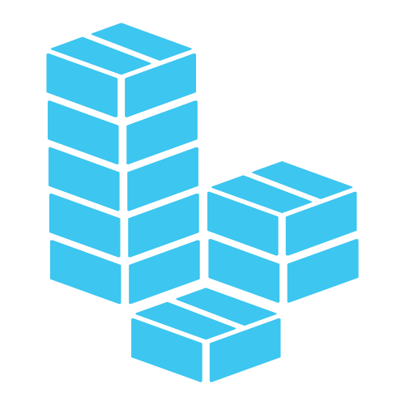
What is a container?
Notes:
Definition:
Containers have existed for decades, but most modern developers remember 2013 as the start of the modern container era with the introduction of Docker.
Containers are executable units of software in which the application code is packaged, along with its libraries and dependencies. They can be run from anywhere, on-prem, private and public cloud.
Containers take advantage of virtualization and are leverage to isolate processes and control the amount of CPU, memory and disk that those processes have access to.
Containers are not VMs.
VMs virtualize the underlying hardware while containers virtualize the operating system (typically Linux).
The absence of a guest OS is what makes containers lightweight, fast and portable.
Containers also enable microservice architectures because application components can be deployed and scale at a granular level. This is beneficial because developers don’t have to scale up entire monolithic applications, but rather a singe component that might be struggling to load.
Use Cases
Microservices: loosely coupled and independently deployable smaller services
DevOps: combination of microservices as an architecture and containers as a platform
Hybrid, multi-cloud environments: containers can run consistently anywhere
Developers: application modernization and migration to the cloud

Slide 4
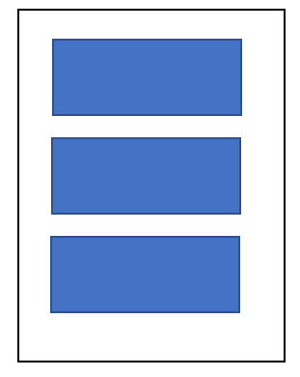
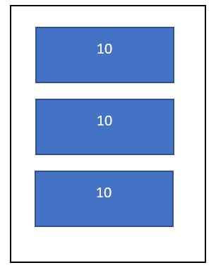
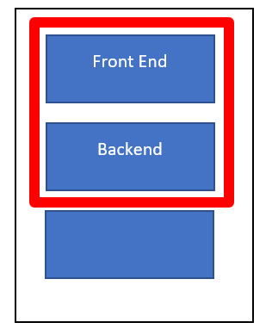
Why container orchestration?
Notes:
Managing large number of containers across a distributed system is complex.
Container orchestration emerged to manage large volumes of containers throughout their lifecycle: provisioning, redundancy, health monitoring, resource allocation, scaling and load balancing, and moving between physical hosts.
Some example of container orchestration platforms are Apache Mesos, Nomad, and Docker Swarm.
Purpose
The idea is that you don’t have to spend a lot of time trying to figure out when and why a container goes down and how to fix it, the customization of the DNS or the networking, and you just simply let it go down and then beyond that one you let the system handle the failure, either bringing exactly the same back on the same VM or in another VM depending on the configuration and rules regarding resource allocation.
For those who have worked with Dockers, in the Dockers world this system is called swarm. Alternative to swarm is Kubernetes.

Slide 5


Notes:
Kubernetes
- Open-source project introduce by Google in 2014.
It was donated to the Cloud Native Computing Foundation.
It is a container orchestration platform.
Kubernetes enables developers and operators to declare the desire state of their overall container environment through YAML files.
Kubernetes establish and maintain the state with activities that include deploying, rebooting, load balancing, auto scaling, among others.
Best use case: Companies with Cloud Native Maturity

Slide 6
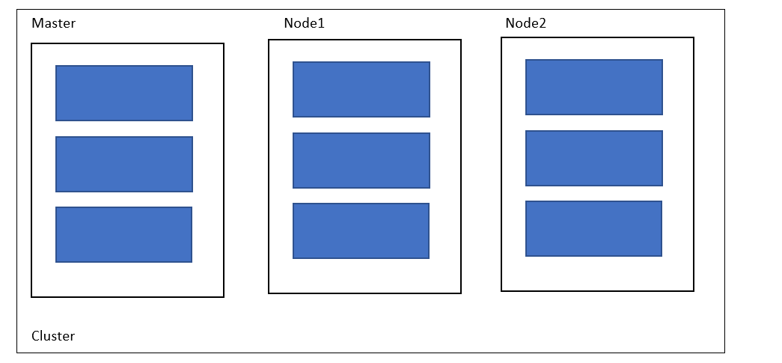
Kubernetes Cluster Architecture
Notes:
We know that you can have VM with Dockers running containers inside the VM. And we saw that when you have multiple VMs you need a structure that sits around the entire system and that is orchestration. Basically, in this setup you have essentially a Kubernetes cluster.
It is worth mentioning that you could also have a cluster out of a single Master, but that will give you a single point of failure which basically defeats the whole purpose.

Slide 7
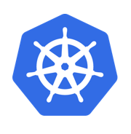
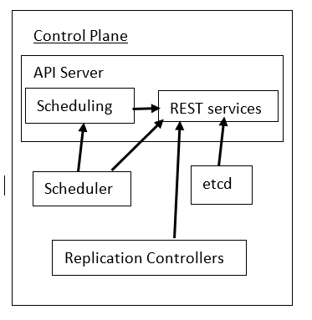

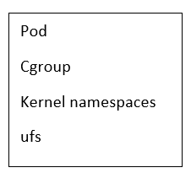
Master
Notes:
Master
They are responsible for the whole cluster, and they are the ones making decisions about which nodes to schedule application services on.
Scheduling in this contexts means assigning the application services to the various nodes.
The Master have several components and all of those components together are called control plane.
The main piece is the API server and that server as you can see handles scheduling and scheduling ultimately goes through REST services.
You have 3 more components below. You have the Scheduler which it will go into the scheduling piece of the API server, and it can also go into the REST services directly.
We have the replication controllers and those will be handling the replicas. Replica is a series of pods realizing other pods.
Pods are a series of multiple cgroups, kernel namespaces and unit capable file systems (ufs).
The last component is the etcd which manages state. It is the database essentially of all Kubernetes. It tells Kubernetes who is available and what state all available things are. It is worth mentioning that etcd is a distributed, consistent and watchable key-value store.

Slide 8
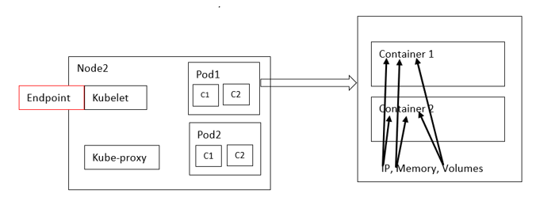

Node
Notes:
Node
The node has 2 major components: the Kubelet and the Kube-proxy.
The Kube-proxy allow network traffic to come in and then be re-directed into one of the various pods. As mentioned before inside of those pods is where you find containers, and the container engine is what is running all of these containers. An example of an engine is Docker.
Kubelet is an agent, and its job is to communicate back to the master, so there is a kubelet in every node. If a pod goes down is the kubelet the one that communicates that back to the master. Worth mentioning the kubelet do not start the pod, the master do that, and that work is exposed, and its called endpoint and it that happens on a TCP port 10255.
If a pod contains more than one container then the IP address of the first container is the same IP address of the second container and the same is true for memory and volumes. This means that if container 1 needs to talk with container 2, it can use local host to do so.

Slide 9
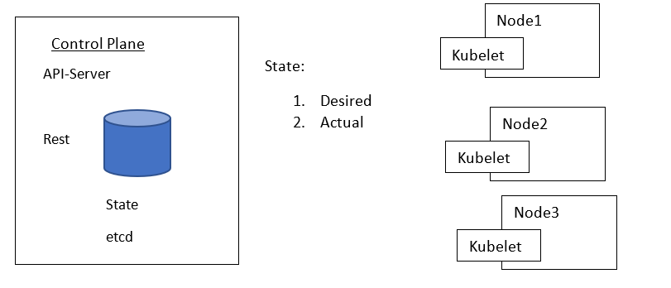
Kubernetes Master and Scheduler
Notes:
Kubernetes Master and Scheduler
Ectd holds the state. Broadly speaking there are 2 kinds of states: 1. The desired and 2. The actual state.
We configure Kubernetes by feeding YAML files into the master. Usually that is done with the kubectl command which uses a post connection when you are creating things. And it uses the HTTP method because the recipient in the other end is REST and so kubectl is doing REST calls; that is the desired state of running pods.
The desired state might not match the actual state, and the actual state is found on the etcd database.
The main purpose of the master is to determine if the desired state is equal to the actual state.
Most if not all components of Kubernetes are trying to figure out that same question.
If a node pod goes down, the kubelet is going to contact the master and that will update the state. And now the scheduler gets involved.
The scheduler coordinates with the Kubelet to see which node is going to host the new pod and it does that by determining which node has the load capacity.
The node with the required capacity will be the one hosting that pod.

Slide 10
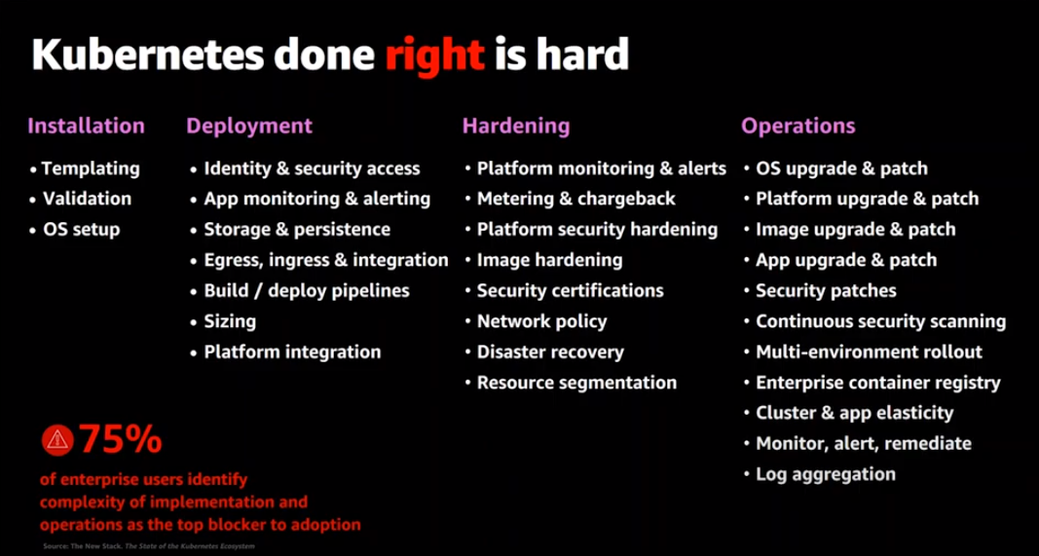

Slide 11
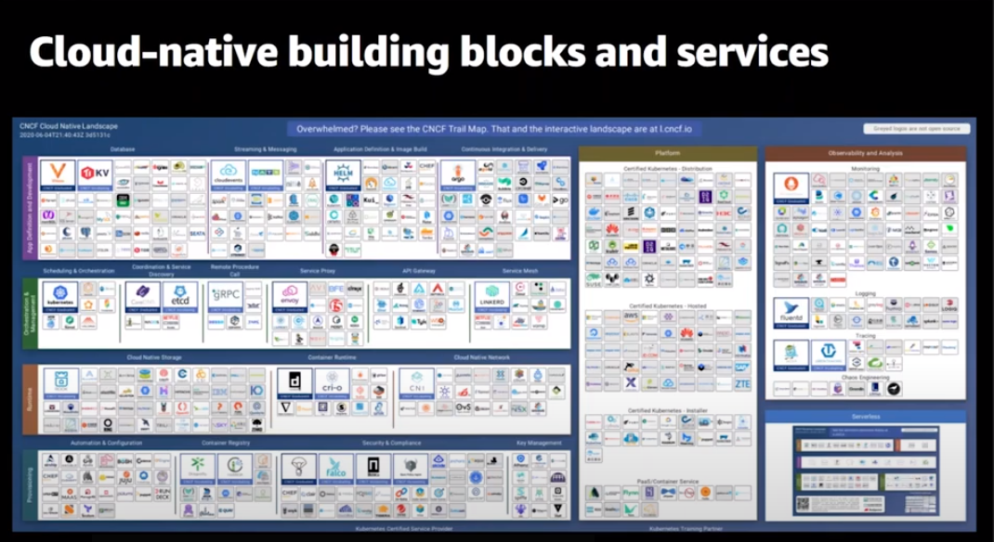
Notes:
Cloud environment services options/ Red Hat OpenShift
Linux is the foundation of these technologies
100s of services options
Source tools -> compatibility

Slide 12
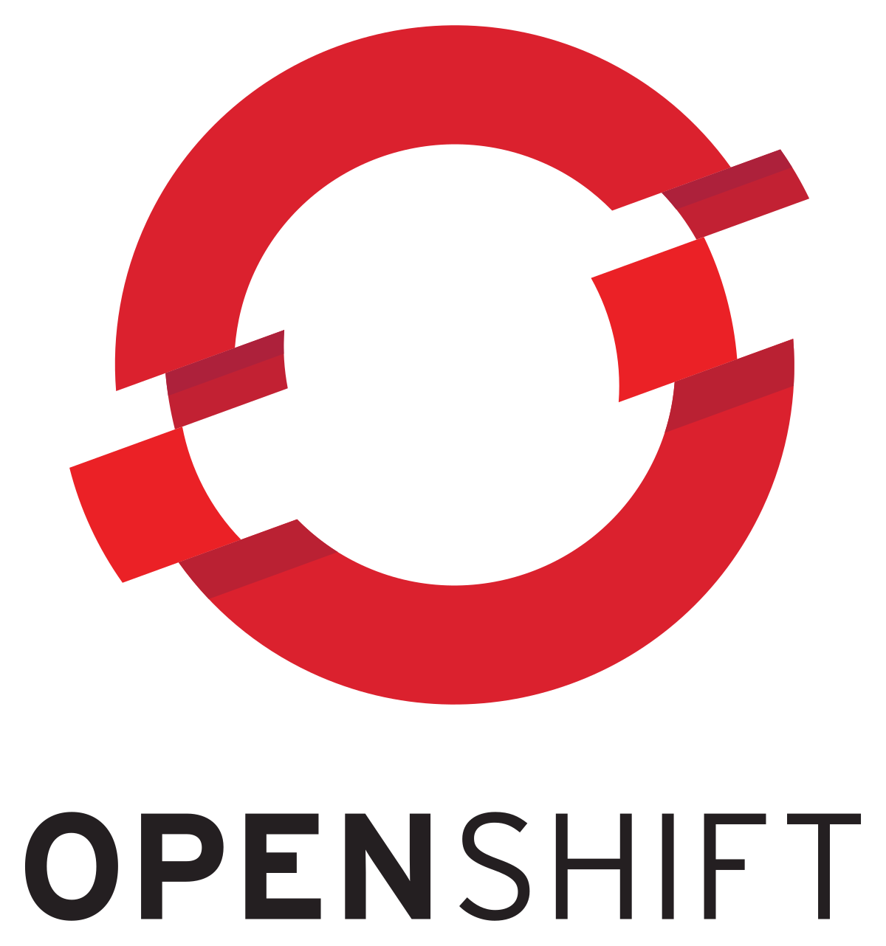
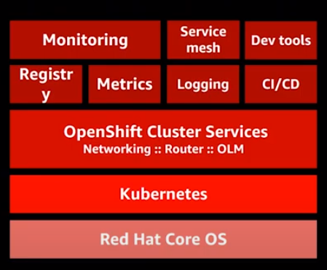
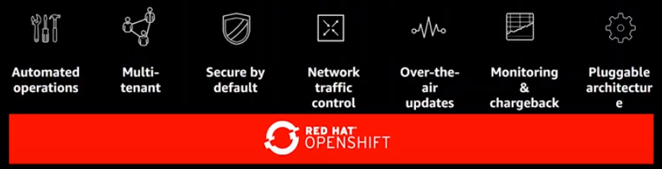
The Kubernetes platform for the enterprise
https://cloud.redhat.com/openshift/
Notes:
OpenShift
Red Hat OpenShift lets you operate consistently and innovate continuously regardless of where your applications reside today or where you put them tomorrow. It extends the capabilities of Kubernetes in smaller footprint options including 3-node cluster, remote worker node topology or a combination.
With Red Hat OpenShift, developers build and manage applications consistently across hybrid, multi-cloud, and edge locations. IT operation teams benefit from nearly autonomous operations using operators that simplify the management of IT resources as application install, update and failover.

Slide 13
Kubernetes vs OpenShift
Deploy an Application
Pull code from repository to local machine | Create an application and a project
Spin up a container
Host container in a registry (ex. Docker Hub or private registry)
Figure out CIDC story
Managing an Application
Default dashboard not enough so additional dashboards might be needed (ex. ELK stack, Grafana, etc.) | Web console that build on the K8s API's
 | Automated installers & Ansible playbooks
Day to Day Operations/ Node Configuration
Creating new VMs is time consuming and require scripts to be developed (setting up self-registration, different cloud automations for setting up new VMs etc.). | Ansible playbooks and installers to bring new VMs into the cluster
 | Handles auto-scaling and load-balancing
Security
RBAC | Add the users to the project and security features are automatically assigned
IAM | It handles Kubernetes name spacing
AUTH needs to be build out and it is time consuming
Notes:
Red Hat tests, validates, and integrates components of the whole stack for you.
OpenShift: Opinionated and Prescribed approach
Kubernetes: Flexible and takes advantage of legacy systems
OpenShift is not for every organization. Understanding the underlying fundamentals of Kubernetes that power OpenShift is required.

Slide 14

Red Hat OpenShift Services on AWS (Rosa)
https://aws.amazon.com/rosa/
Notes:
Red Hat OpenShift Services on AWS (Rosa)
Use via command line only available currently
Service comparable to EKS or EKS Tuttle
With ROSA, you can use the wide range of AWS compute, database, analytics, machine learning, networking, mobile, and other services to build secure and scalable applications faster.
ROSA comes with pay-as-you-go hourly and annual billing, a 99.95% SLA, and joint support from AWS and Red Hat.
ROSA makes it easier for you to focus on deploying applications and accelerating innovation by moving the cluster lifecycle management to Red Hat and AWS. With ROSA, you can run containerized applications with your existing OpenShift workflows and reduce the complexity of management.

Slide 15
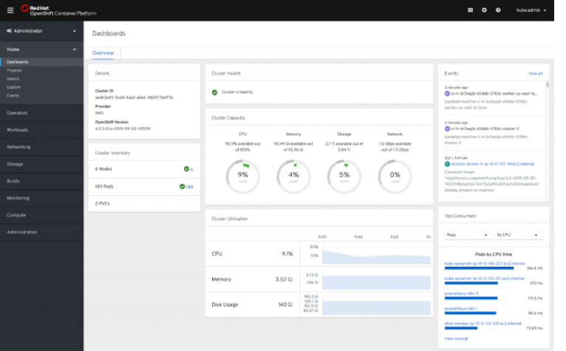

Slide 16
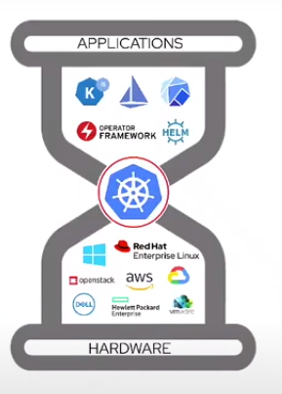
Thank you!

Slide 17
References
https://www.redhat.com/en
https://docs.openshift.com/container-platform/4.2/cli_reference/openshift_cli/getting-started-cli.html
https://aws.amazon.com/rosa/
https://kubernetes.io/
https://www.ibm.com/cloud/redhat

